Slide 1
Predicting Post Subreddits with NLP
By: Andrew Goodwin, Joe Mazanec, Tim Bryan, Sodiq Alagbada

Slide 2

Introduction
Our team has set out to create a model for predicting in what subreddit a given post would most likely be made.
Our goal would be to pitch the model for use primarily by advertising companies in their strategy for targeted, online ads, but it could have other applications.

Slide 3
Workflow Diagram
Downloaded dataset to local machine and preprocessed using Pandas, exported as Parquet file.
Loaded file into an S3 Bucket.
Connected S3 Bucket to DataBricks and loaded in file.
Performed feature transformations (tokenizer, stopremove, hashingTF, idf).
Trained and tuned model to improve accuracy.
Visualized trends in dataset with Tableau.

Slide 4

Dataset Details
Original Dataset: Hugging Face ‘reddit’.
Columns: User ID, Subreddit, full text of post, summary text of post.
Size: ~3.8 million posts, 20 GB.
Method of Creation: Web scraping
Credits: Volske, Michael and Potthast, Martin and Syed, Shahbaz and Stein, Benno

Slide 5
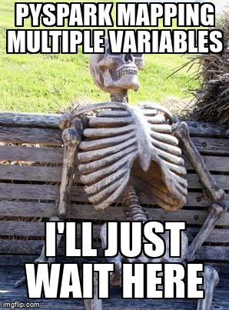
Data Preprocessing
Imported dataset on to local computer.
Assessed data structure.
Pandas struggled to load past 1 million row data frame, so created four data frames around 1 million rows each.
Summed value counts of subreddit column for each data frame to generate list of top ten subreddits by activity.
Filtered each data frame down to only include posts from top ten subreddit list.
Combined data frames into one data frame and exported as a parquet file.

Slide 6
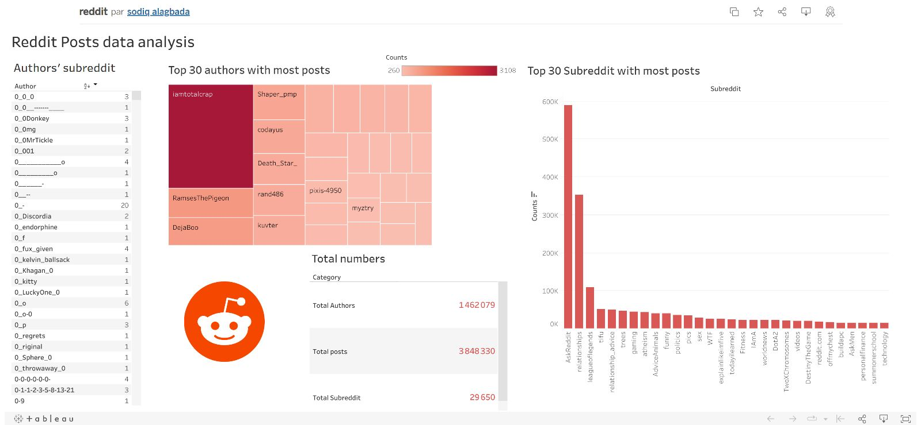
Visualizations

Slide 7

Machine Learning Assembly
Loaded parquet file into Databricks from S3 buckets.
Selected feature(s) (body) and target (subreddit).
Transformed feature using…
String indexer
Tokenizer
Stop word remover
Hashing term frequency
Inverse document frequency
Created models to fit and transform data.
Evaluated model accuracy.

Slide 8
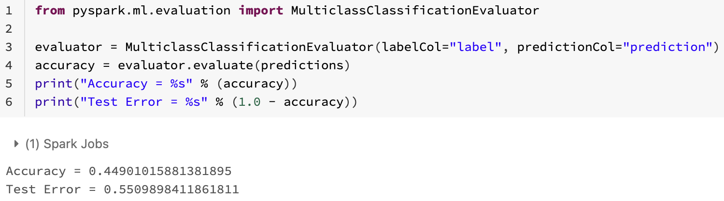
Machine Learning Results
Model: Random Forest model
Accuracy: 45%
First, we tried a random forest model. The load time here was approximately 2 hours for a not convincing accuracy score. We believe there are too many features being considered for this type of model to be effective in this case.

Slide 9
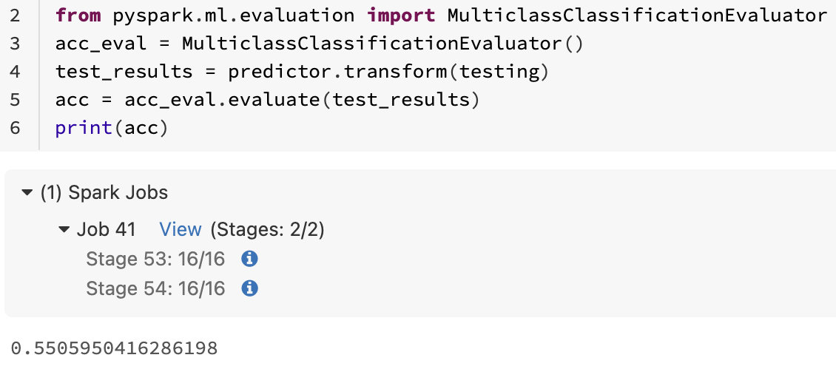
Machine Learning Results
Model: Naive Bayes model
Accuracy: 55%
Second, we tried a Naive Bayes model. This model loaded much more quickly and gave a reasonably better accuracy score. These numbers are still not where we would like, but this dataset is very complicated with a large vocabulary, and thus will require more tuning.

Slide 10
Conclusion
Our group was able to generate a model for predicting which of the top ten subreddits a particular post would belong. We do not believe the model is ready for use just yet, with an accuracy score of only 55%.
Next steps to improve model would be…
Tune parameters of current model.
Create another model type to handle data better.
After model improvement, we would write script to take in a post and predict the subreddit to which it would most likely be posted.

